Slide 1
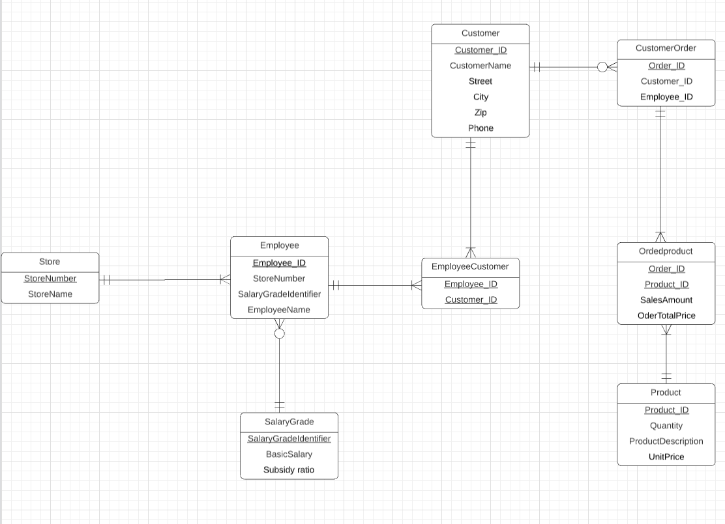
Agenda
Focus
01 / Overview
02 / Entity Relationship
03 / SQL Queries Retrieval
04 / Data Integrity
14376646
YUMENG QIN

Slide 2

Agenda
01 / Overview
02 / Entity Relationship
03 / SQL Queries Retrieval
04 / Domain Integrity
05 /ON DELETE RESTRICT&ON DELETE CASCADE
06 /The use of a view in my SQL

Slide 3
01 Overview
part one

Slide 4
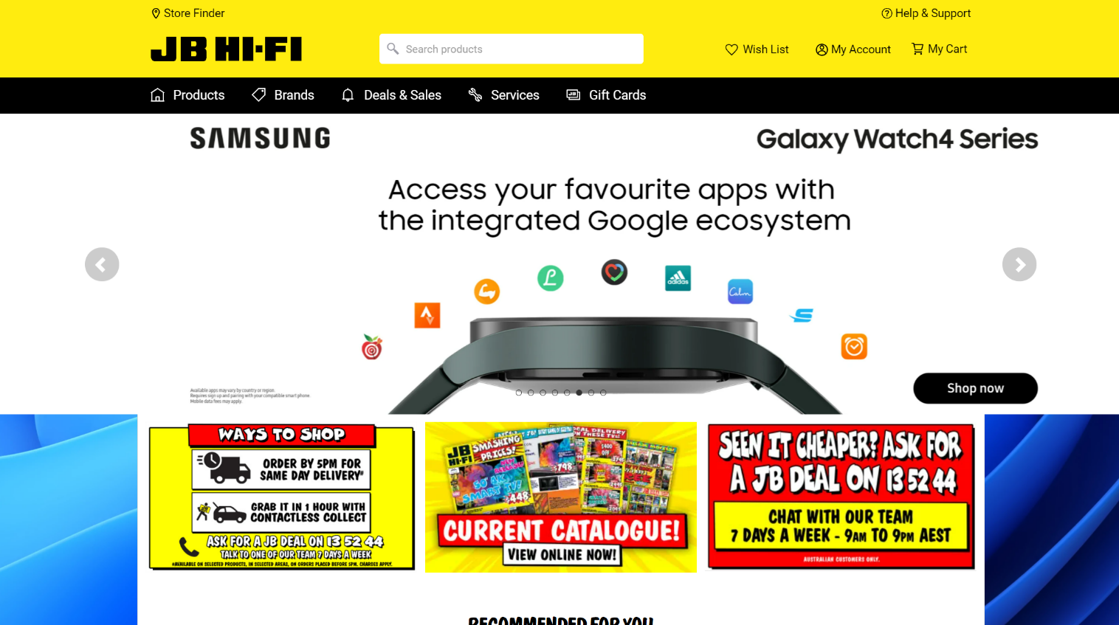
Goal: JB HI-FI have many store in Australia. Through different entities, we can calculate different employee’s salary according to their individual performance. This goal can be achieved by SQL Queries. Also, for each employee, we can see which type of product they are good at to sell. For this reason, we can allocate different employee to sell product which they are good at.
JB HI-FI offer the world's leading brands of Computers, Tablets, TVs, Cameras, Hi-Fi, Speakers, Home Theatre, Portable Audio, the largest range of games, recorded music, DVD music, Blu-Ray and DVD movies and TV shows and stacks more all at cheap prices! Everything you're after is available in one of our stores or online. JB Hi-Fi has it all - best brands, huge range, cheapest prices, convenient locations, but most importantly genuine personal service from our experienced specialist staff.

Slide 5
02 Entity Relationship Diagram
part two

Slide 6
JIBIHIFI

Slide 7
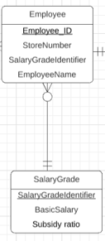
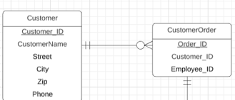
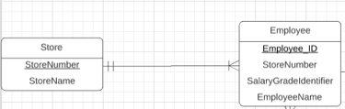
One to Many

Slide 8
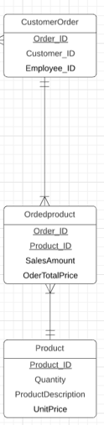
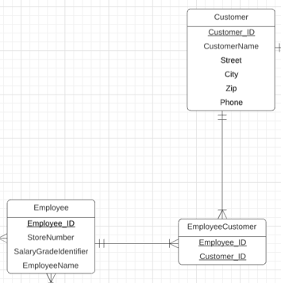
Many-Many

Slide 9
03 SQL Queries
part three

Slide 10
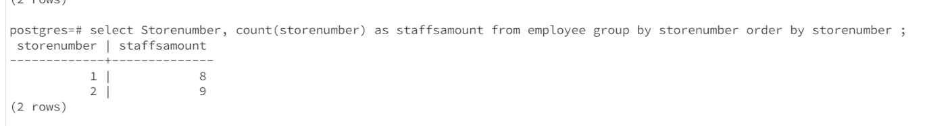
A simple query of a single table
Goal: find out the amount of employee in each store.
postgres=# select Storenumber, count(storenumber) as staffsamount
from employee group by storenumber
order by storenumber ;

Slide 11
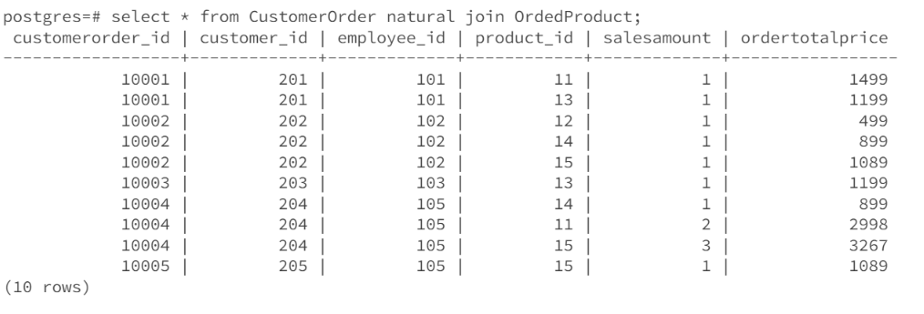
A query which uses the words "natural join"
If we want to know each transaction details, we can natural join order entity and ordered product entity. After using this way, we can forward use different queries to get different result through group by query.
select * from CustomerOrder natural join OrderProduct;

Slide 12
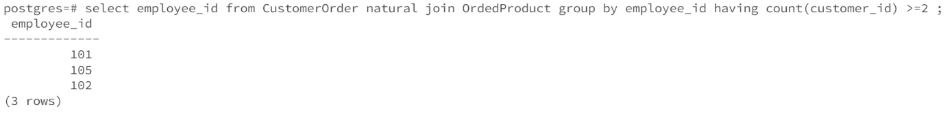
A query involving a “Group by”, also with a “HAVING”
Goal: find out employee who serve equal or more than 2 customer.
Meaningful: if we define an outstanding employee is who serve equal or more than 2 customers, we can find out outstanding employees.
postgres=# select employee_id from CustomerOrder natural join OrdedProduct group by employee_id having count(customer_id) >=2 ;

Slide 13
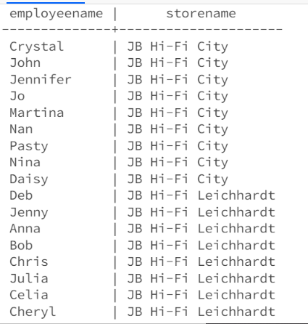
The cross product equivalent to the "natural join" query above
select employeename,storename
from employee,store
where store.storenumber = employee.storenumber
order by storename;
Goal: find out every employee work in which store

Slide 14
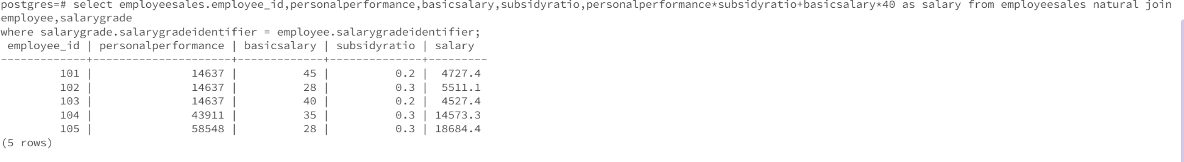
The cross product equivalent to the "natural join" query above
postgres=# select employeesales.employee_id,personalperformance,basicsalary,subsidyratio,personalperformance*subsidyratio+basicsalary*40 as salary from employeesales natural join employee,salarygrade where salarygrade.salarygradeidentifier = employee.salarygradeidentifier;
Goal: we can calculate different employee’s salary according to their individual performance.

Slide 15

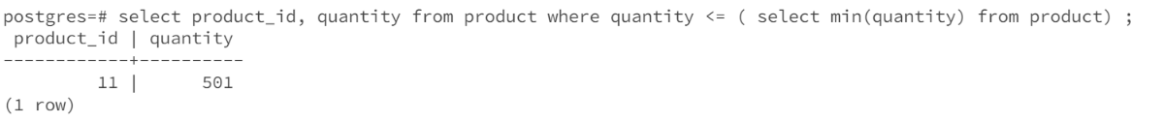
A query which uses a sub query
Goal: find out which product has the minimize stock.
Meaning: manager can ask employee to recommend other product instead of minimized stock product to customer.
postgres=# select product_id, quantity from product where quantity <= ( select min(quantity) from product) ;

Slide 16
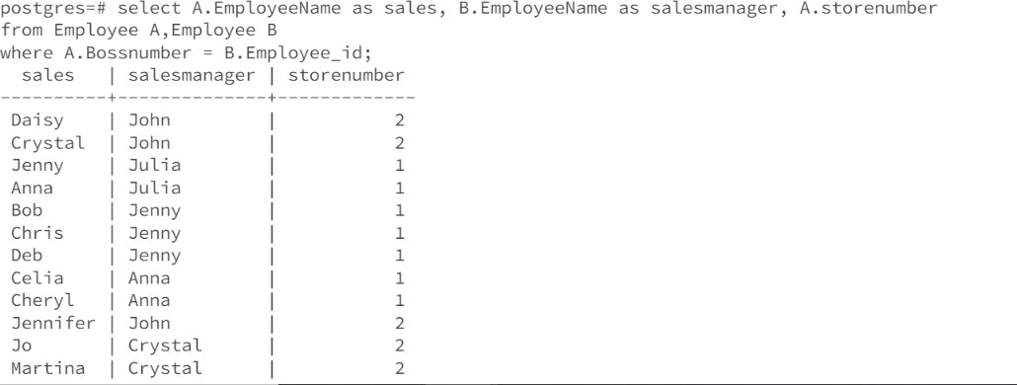
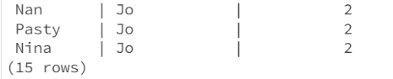
A cross product which cannot be implemented using the words “natural join” (e.g. self join)
Goal: According to self join, we can see different sales’s manager with their store number
postgres=# select A.EmployeeName as sales, B.EmployeeName as salesmanager, A.storenumber from Employee A,Employee B where A.Bossnumber = B.Employee_id;

Slide 17
04 Domain Integrity
part four

Slide 18
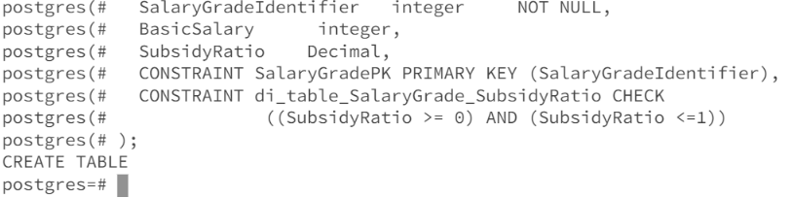
Check statement

Slide 19
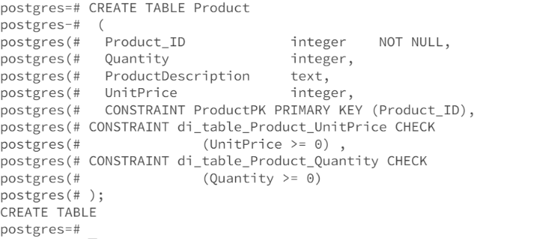
Check statement

Slide 20
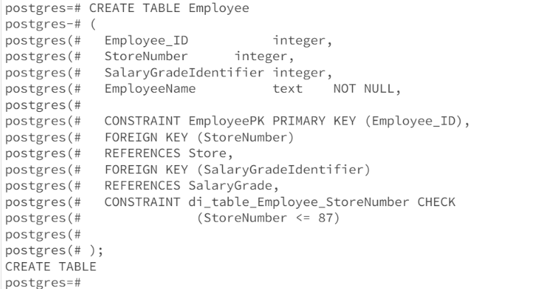
Check statement

Slide 21
05 ON DELETE RESTRICT&ON DELETE CASCADE

Slide 22
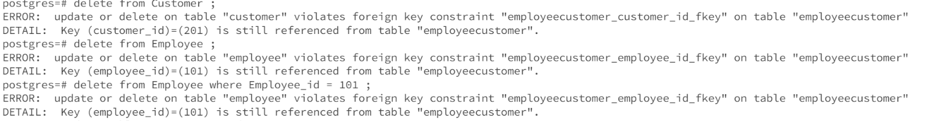
On delete restrict

Slide 23
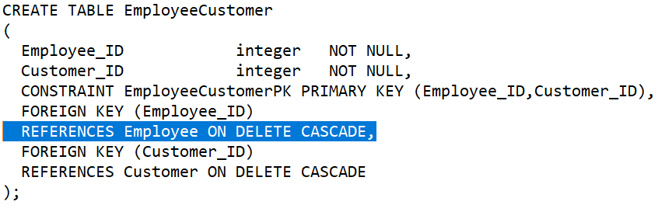
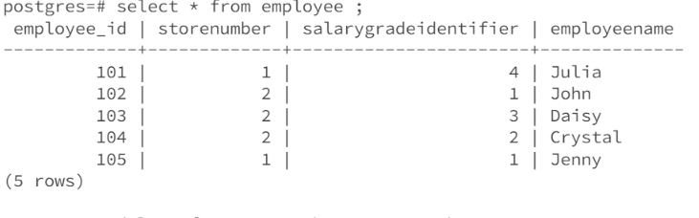
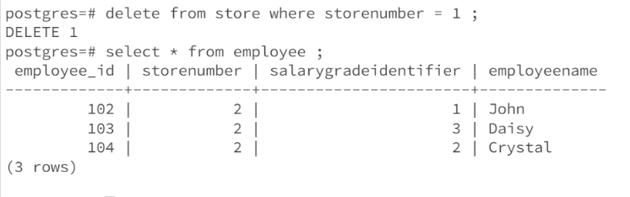
After I add ON DELETE CASCADE
On delete Cascade

Slide 24
06 the use of a view in my SQL

Slide 25
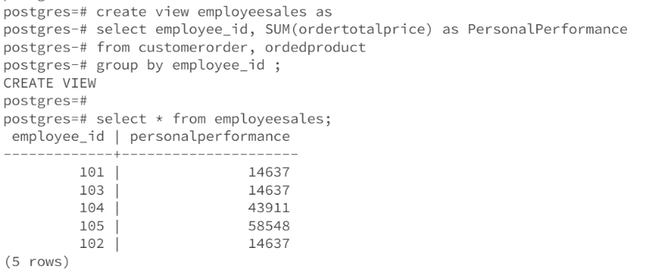
Goal: build a new ‘employeesales’ entity to show each employee’s sales performance
The use of a view in SQL

